Slide 1
Understanding Covid-19 Variants
in
European Countries
Presented By:
Miranda Melton
Payal Bansal
Zachary Pederson

Slide 2
Table of Contents
Opening Slide
Table of Contents
Introduction
Why Study Variants
Technologies Used
Data Source
Cleaning Process
Top Variants across different Countries
Interactive bar chart - top variants by Year
Heatmaps for Variants
Conclusions
Implications/Limitations
Questions
Thank You
Notes:
Payal

Slide 3
Introduction
Covid - 19 is caused by the SARS-CoV-2 virus.
First identified in late 2019 in Wuhan, China, Covid-19 quickly became a global pandemic.
It has affected lives in many ways:
Health Crisis
Economical Disruption
Social Impact
Mental Health
Education Disruption
Global Response
Long-term Implications
Notes:
Payal

Slide 4
Why Study Variants
COVID-19 variants are strains of the virus that have genetic differences from the original strain, primarily due to mutations.
Viruses like SARS-CoV-2 mutate over time, leading to the emergence of new variants.
Continuous monitoring of variants is essential to stay ahead of the virus, adapt public health strategies, and maintain the effectiveness of vaccines and treatments.
Variants may impact:
Transmissibility: Some variants spread more easily than others.
Severity: Variants can cause different levels of illness and complications.
Vaccine effectiveness: Certain variants may be less susceptible to vaccines.
Notes:
Payal

Slide 5
Technologies Used
Python
Github
Novel COVID19 API
Libraries and Modules:
Requests
NumPy
JSON
PPrint
Plotly
Ipywidgets
sns
Math
Integrated Development Environment(IDE)
Jupyter Notebook
Notes:
Miranda

Slide 6
Data Source
We have used Open source API data from (https://disease.sh/docs/#/COVID-19%3A%20JHUCSSE/get_v3_covid_19_historical_all)
We have selected COVID-19 Variants data for 6 different European Countries using (https://disease.sh/v3/covid-19/variants/<country_name>/
France
Germany
Ireland
Italy
Norway
Sweden
Notes:
Zach

Slide 7
Data Cleaning Process
Take the API links and turn the JSON data into individual JSON Files
Take the JSON files and Convert them to CSV files to be saved in a separate folder
Turn the CSV files into DataFrames
Merge all the Data Frames together
Rename the columns
Export the merged Data Frame as a CSV file and save it in the folder
Upload the CSV files into a database management system of choice
Notes:
Miranda

Slide 8
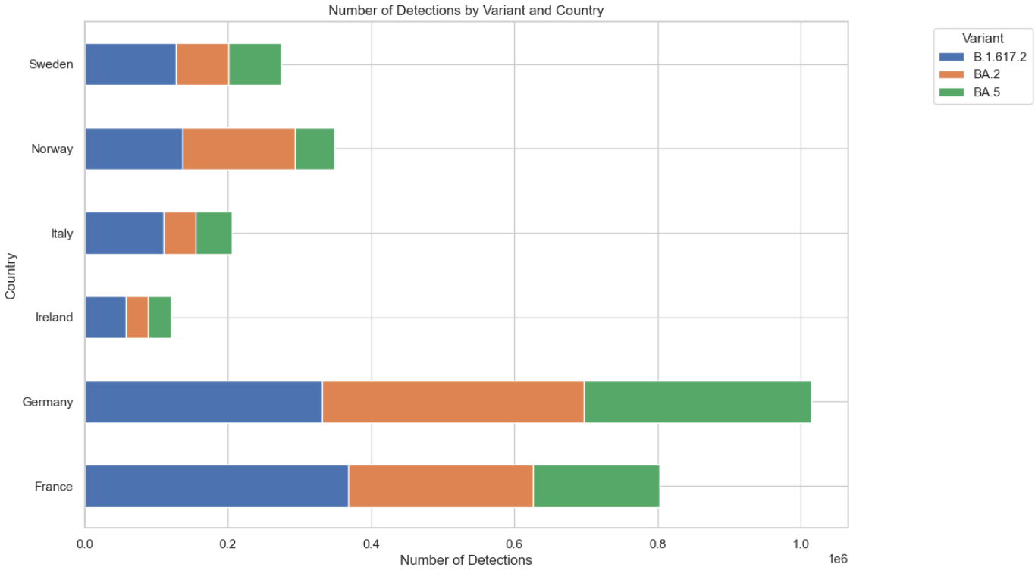
Top Variants across Multiple Countries
This visualizations shows the impact of most severe variants across different countries
Variants exhibit varying prevalence across countries, reflecting geographical differences in COVID-19 dynamics
From this graph we can see that Germany and France are the most affected countries for different variants and Ireland is the least affected
The variant B.1.617.2(Delta) has most cases in all the countries.
Notes:
Payal

Slide 9
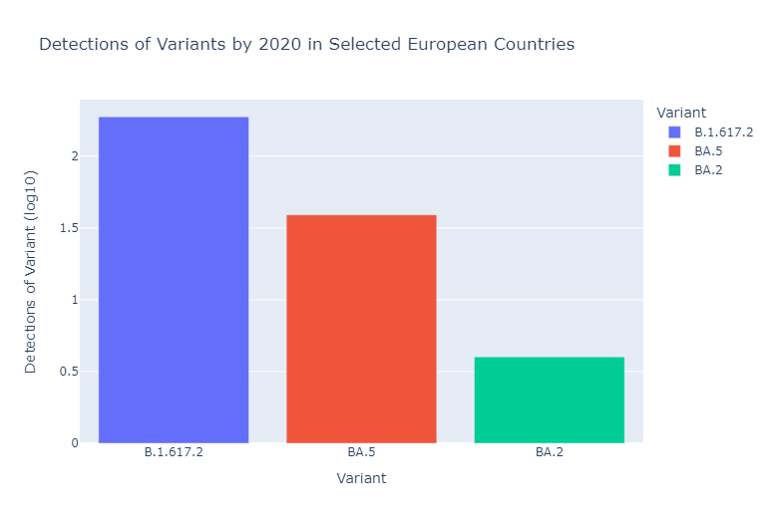
Top Variants by Year
Examined the total number of cases of 3 of the most prominent Covid-19 Variants from 2020-2023
“Interactive Bar Chart” for full functionality
Notes:
Miranda

Slide 10
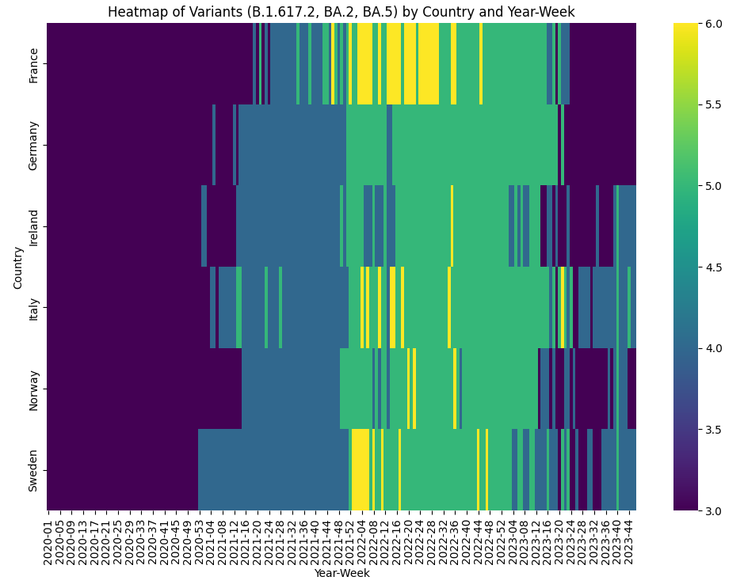
Visualization of frequency of 3 specific variants across Europe
Data spans from 2020 to 2023, approximately the duration of the pandemic in EU
2022 showed the most variant activity across our 6 countries
France had the most recorded instances of different covid variants
Notes:
Zach

Slide 11
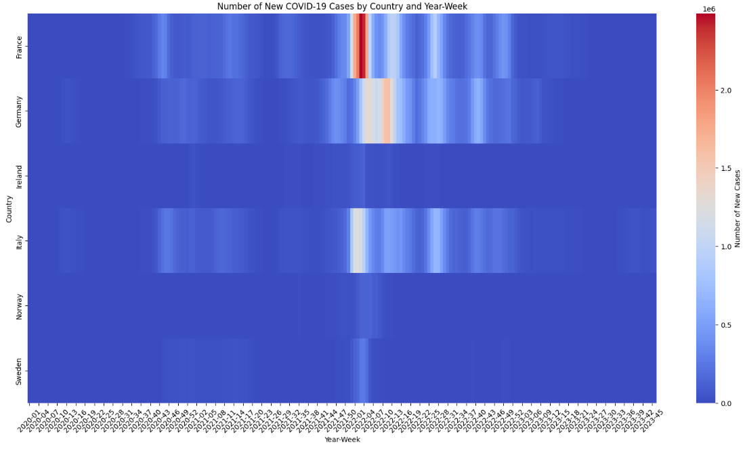
Visualization of total cases across Europe
Most populated countries have highest reported cases
France had the highest number of new cases, Germany had the most consistent
Notes:
Zach

Slide 12
Conclusions
Importance of Studying Variants
Public Health Strategies
Vaccine Development
Disease Control
The Delta variant(B.1.617.2) is very dominant and number of detections increase due to its increased transmissibility compared to earlier variants
For the years 2020 and 2021, the most prominent variant was variant B.1.617.2 or “Delta” variant
In 2022 and 2023, the most prominent variants were BA.2 and BA.5 (Omicron sub-variants)
2022 showed the most variant activity across our 6 countries
France had the most recorded instances of different covid variants
Notes:
Miranda

Slide 13
Implications/Limitations
It is important to recognize several limitations associated with this type of data. Understanding these limitations helps contextualize the findings and informs interpretation and decision-making
Sampling Bias
The data may be subject to sampling bias, as genomic sequencing efforts vary widely between countries and regions. Countries with more robust sequencing capabilities may detect and report more variants compared to those with limited resources
Selection Bias in Data Representation
The data may overrepresent certain populations or demographics, particularly if sequencing efforts target specific groups or regions. This can skew the observed variant distribution
Incomplete Sequencing Coverage
Not all COVID-19 cases undergo genomic sequencing, leading to underrepresentation of certain variants in the data. This can result in an incomplete picture of variant prevalence and distribution.
Notes:
Miranda

Slide 14
Questions??

Slide 15
Thank you

